Slide 1
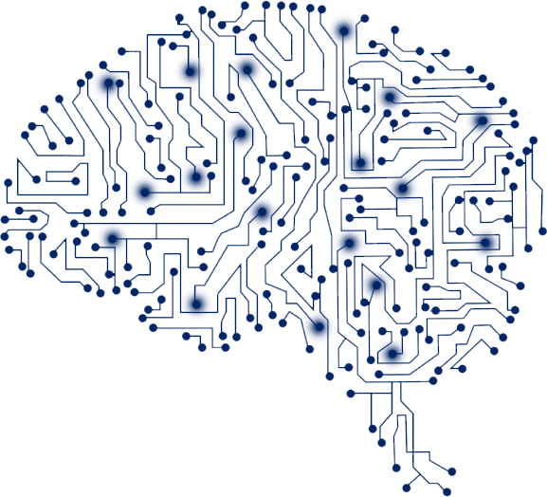
GEMS SORTING MACHINE
BASED ON
ARTIFICIAL
INTELLEGENCE
Vanshaj Goel - R177219196
Utkarsh Gupta - R177219194
Submitted to - Ms. Nupur Jha

Slide 2
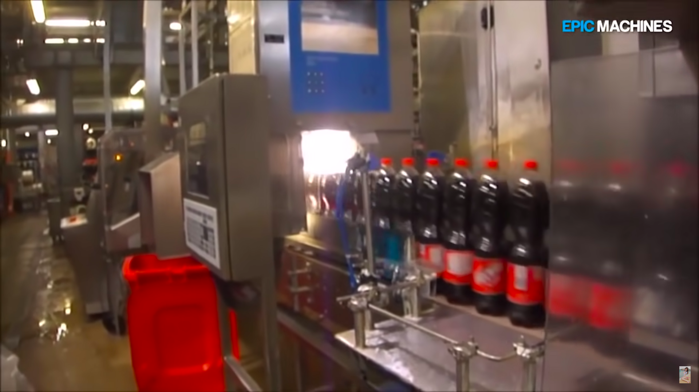
AIM
To replicate a small scale machine that can differentiate similar objects using image recognition. In this particular case, colour detection.
For example Coca-Cola uses a similar industrial level image recognition system to point out the faulty bottles from the main, high speed assembly lines.

Slide 3

WORKING
The system comprises of two main components, hardware and software.
Hardware puts the gems on a conveyer belt, moves it and drops it in dedicated box as per the output from the software.
The software clicks the picture of the gems, feeds it into the neural network. After receiving the output from the neural network it instructs the hardware to drop the gems in a particular box.

Slide 4
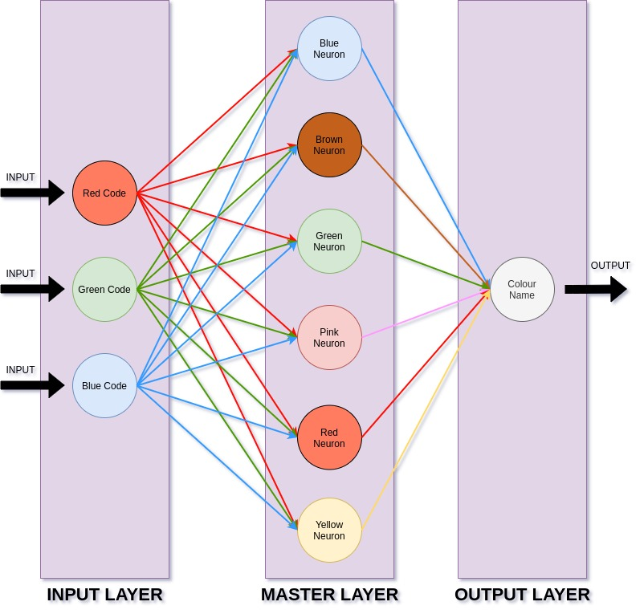
NEURAL NETWORK
The neural network consists of six master neurons for parallel processing of data in six neurons at once. The network is well trained by real time practical data. Every neuron provides a binary output whether it is a certain colour or not.
It consists of three layers-
Input layer
Hidden layer
Output layer

Slide 5
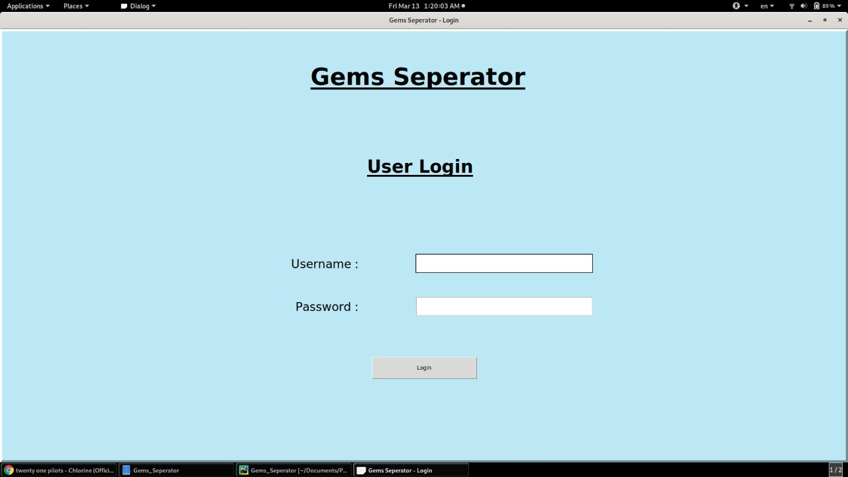
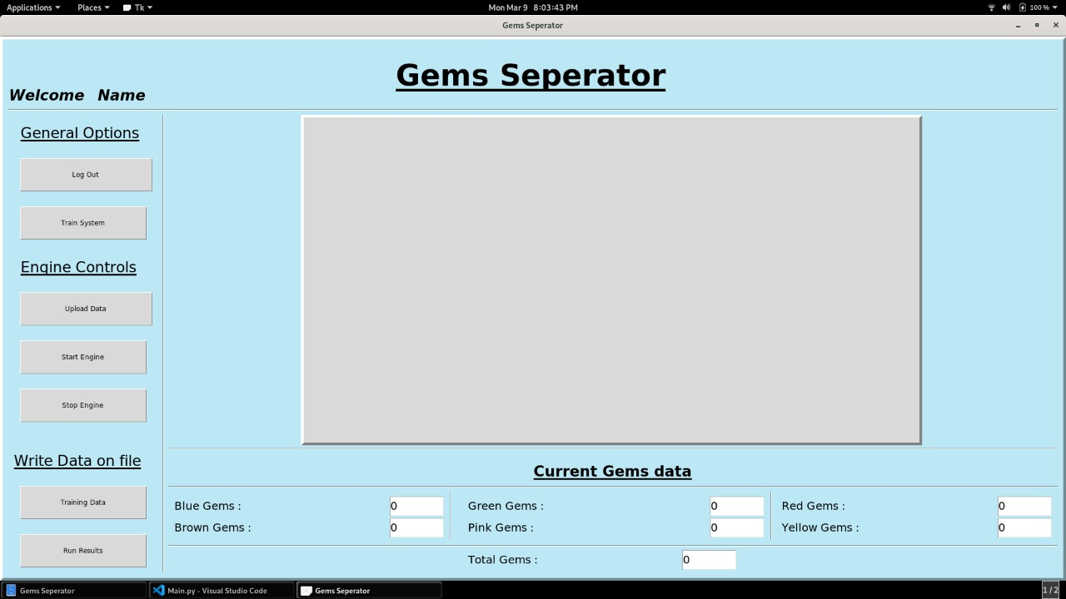
FEATURES
The system has a user interface from which whole machine can be controlled easily.
Software is designed in such a way that user can add or remove a new object or colour easily.
The machine has an incredible accuracy of ~93% due to the very well structured neural network.

Slide 6
REFERENCES
machinelearning.com
youtube.com/epicmachines
youtube.com/codacus
Artificial Neural Network - Saroj Kaushik

Slide 7
THANK YOU!

